Slide 1
CHURN PREDICTION

Slide 2
AYUSH UPADHYAY ANIKET DAS CHIRAG SHARMA TUSHAR NARULA RAJARSHI DAS
PRESENTED BY

Slide 3

Predicting Customer Churn in the Telecommunication Sector
In the competitive telecommunications sector, retaining customers is as crucial as acquiring new ones. Customer churn, the cessation of service by a customer, directly impacts revenue and business viability. Predictive analytics, leveraging big data and machine learning, offers a solution by identifying at-risk customers before they churn.
This project aims to build a high-accuracy model using Random Forest and XGBoost to predict customer churn. By identifying key factors and implementing preventative measures, telecom enterprises can enhance customer retention and improve overall business performance.

Slide 4
Understanding Customer Churn
Revenue Loss
Rising Acquisition Costs
Brand Image
Customer churn leads to a direct loss of subscription revenue. Acquiring new customers is often more expensive than retaining existing ones, making churn a costly problem.
Telecom firms invest heavily in marketing and sales to attract new customers. High churn rates necessitate increased spending on new acquisitions, driving up operational expenditures.
High churn rates can signal poor service quality or customer dissatisfaction. Negative feedback from departing customers can deter potential subscribers, impacting brand reputation.

Slide 5

Objectives of the Project
1
Machine Learning Model
2
Key Churn Drivers
Assess the primary factors driving customer churn, including contract type, monthly fees, tenure, and other relevant variables.
Develop a machine learning model using Random Forest and XGBoost to accurately forecast customer churn in the telecommunications sector.
3
Data Preprocessing
Conduct thorough data preprocessing, including handling missing values, encoding categorical variables, and scaling features for optimal model performance.

Slide 6

Existing Industry Strategy: A Reactive Approach
Most telecom operators employ a reactive approach to churn management, attempting to address the issue after the customer has already left. This often involves providing discounts or promotions to win back lost customers, conducting exit surveys to understand reasons for departure, and increasing advertising efforts to attract new subscribers.
This project aims to shift towards a proactive strategy by predicting churn before it happens, allowing for targeted interventions and improved customer retention.

Slide 7




Leveraging Machine Learning for Churn Prediction
Decision Trees, Random Forest, and Gradient Boosting are popular classification models for predicting churn in the telecommunications sector.
Contract type, monthly charges, tenure, and payment method are significant predictors of churn, according to research.
Methods such as SMOTE (Synthetic Minority Over-sampling Technique) are employed to enhance model performance on imbalanced churn datasets.

Slide 8

Project Scope: Application and Technical Aspects
Telecom Sector
Business Decision-Makers
Assists in identifying vulnerable customers and enhancing customer retention programs through targeted interventions.
Supports data-driven decisions for enhanced customer interaction and tailored offers, improving overall customer satisfaction.
Data Science Students
Provides a real-life case study on using machine learning for business analytics, offering practical experience and insights.

Slide 9
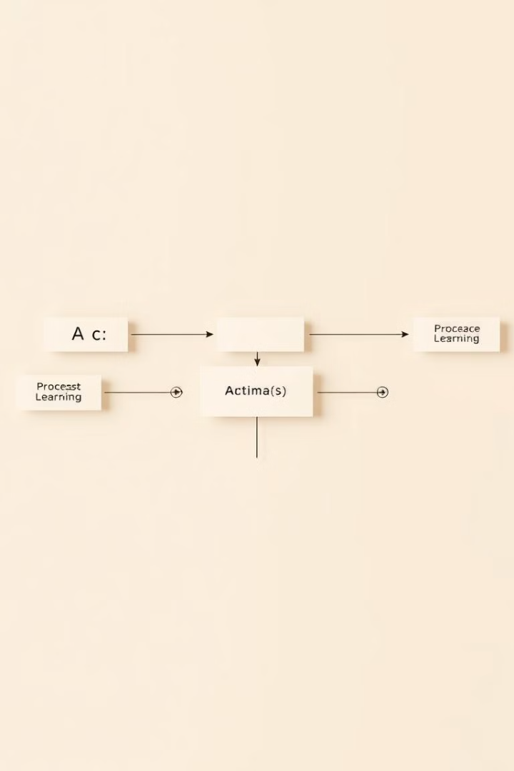



Technical Scope: Tools and Algorithms
Platform
Google Colab provides a cloud-based environment for model deployment, eliminating the need for local software installation.
Algorithms
Random Forest enhances prediction accuracy through ensemble learning, while XGBoost excels at structured data with gradient boosting.
Data Processing
Data processing steps include imputing missing values, encoding categorical variables, and scaling numerical features for improved model performance.

Slide 10
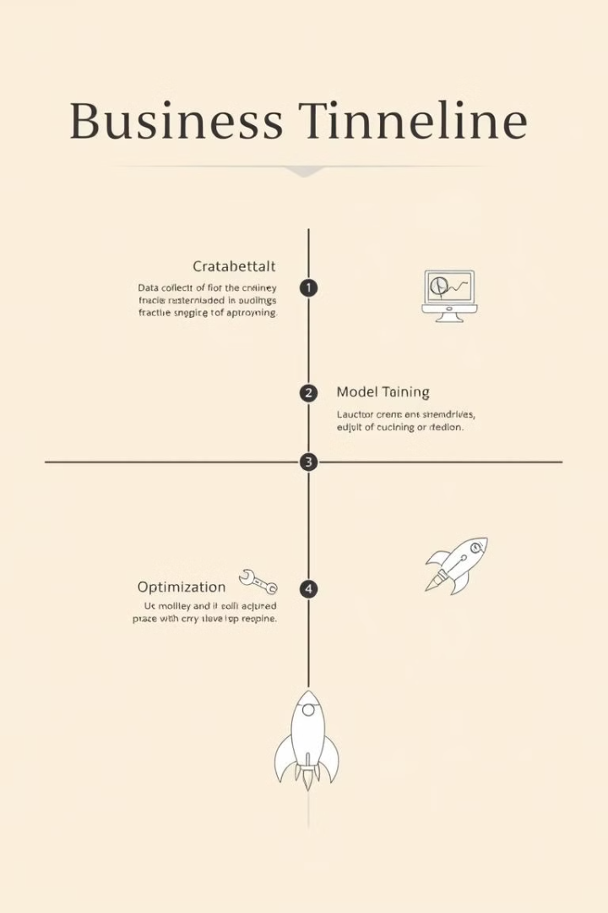
Planning and Task Definition: Project Phases
1
Phase 1: Data Collection & Preprocessing
Load the dataset into Google Colab, check for missing values, convert TotalCharges to numeric, and drop unnecessary columns.
2
Phase 2: Model Selection & Training
Split data into training and testing sets, train Random Forest and XGBoost models, and test models on accuracy, precision, recall, and F1-score.
3
Phase 3: Model Optimization
Perform hyperparameter tuning using GridSearchCV and address class imbalance with SMOTE, if necessary, to improve model performance.

Slide 11
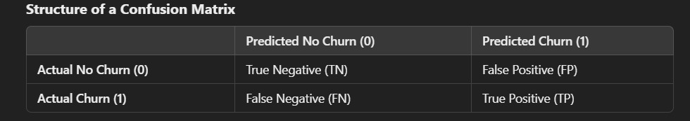
CONFUSION MATRIX
A confusion matrix is a table used to evaluate the performance of a classification model. It compares the actual vs. predicted values and helps measure accuracy, precision, recall, and F1-score.
True Positives (TP): Churn customers correctly predicted as churn
True Negatives (TN): Non-churn customers correctly predicted as non-churn
False Positives (FP): Non-churn customers wrongly predicted as churn (Type I Error)
False Negatives (FN): Churn customers wrongly predicted as non-churn (Type II Error)

Slide 12
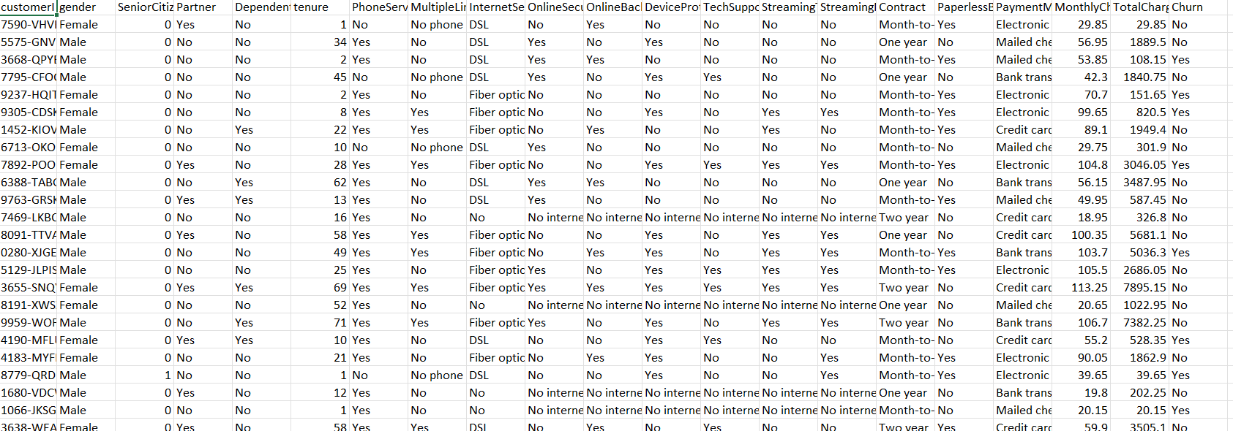
WA_Fn-UseC_-Telco-Customer-Churn.xlsx

Slide 13

Visualization & Reporting: Key Metrics
Create feature importance plots, confusion matrices, and ROC curves to visualize model performance and key drivers of customer churn. Finalize a comprehensive project report and presentation to communicate findings and recommendations.
The project will be executed in Google Colab for smooth execution and ready availability without needing installation software on a user's system.

Slide 14

Final Submission and Documentation
The final phase involves completing all documentation and code, ensuring everything is well-organized and easy to understand. The project will be submitted with a comprehensive report detailing the methodology, results, and conclusions.
This project aims to provide actionable insights for telecom companies to proactively manage customer churn and improve retention strategies.

Slide 15
THANK YOU

